Slide 1

Applied Containerization for Machine Learning in HPC

Slide 2

Applied Containerization for Machine Learning in HPC
Date: October 21, 2025
Instructor: Mohal Khandelwal
Website: http://www.colorado.edu/rc
Documentation: https://curc.readthedocs.io
Helpdesk: rc-help@colorado.edu
Survey: http://tinyurl.com/curc-survey18
Slides
https://github.com/ResearchComputing/applied_containerization_for_ml_short_course

Slide 3
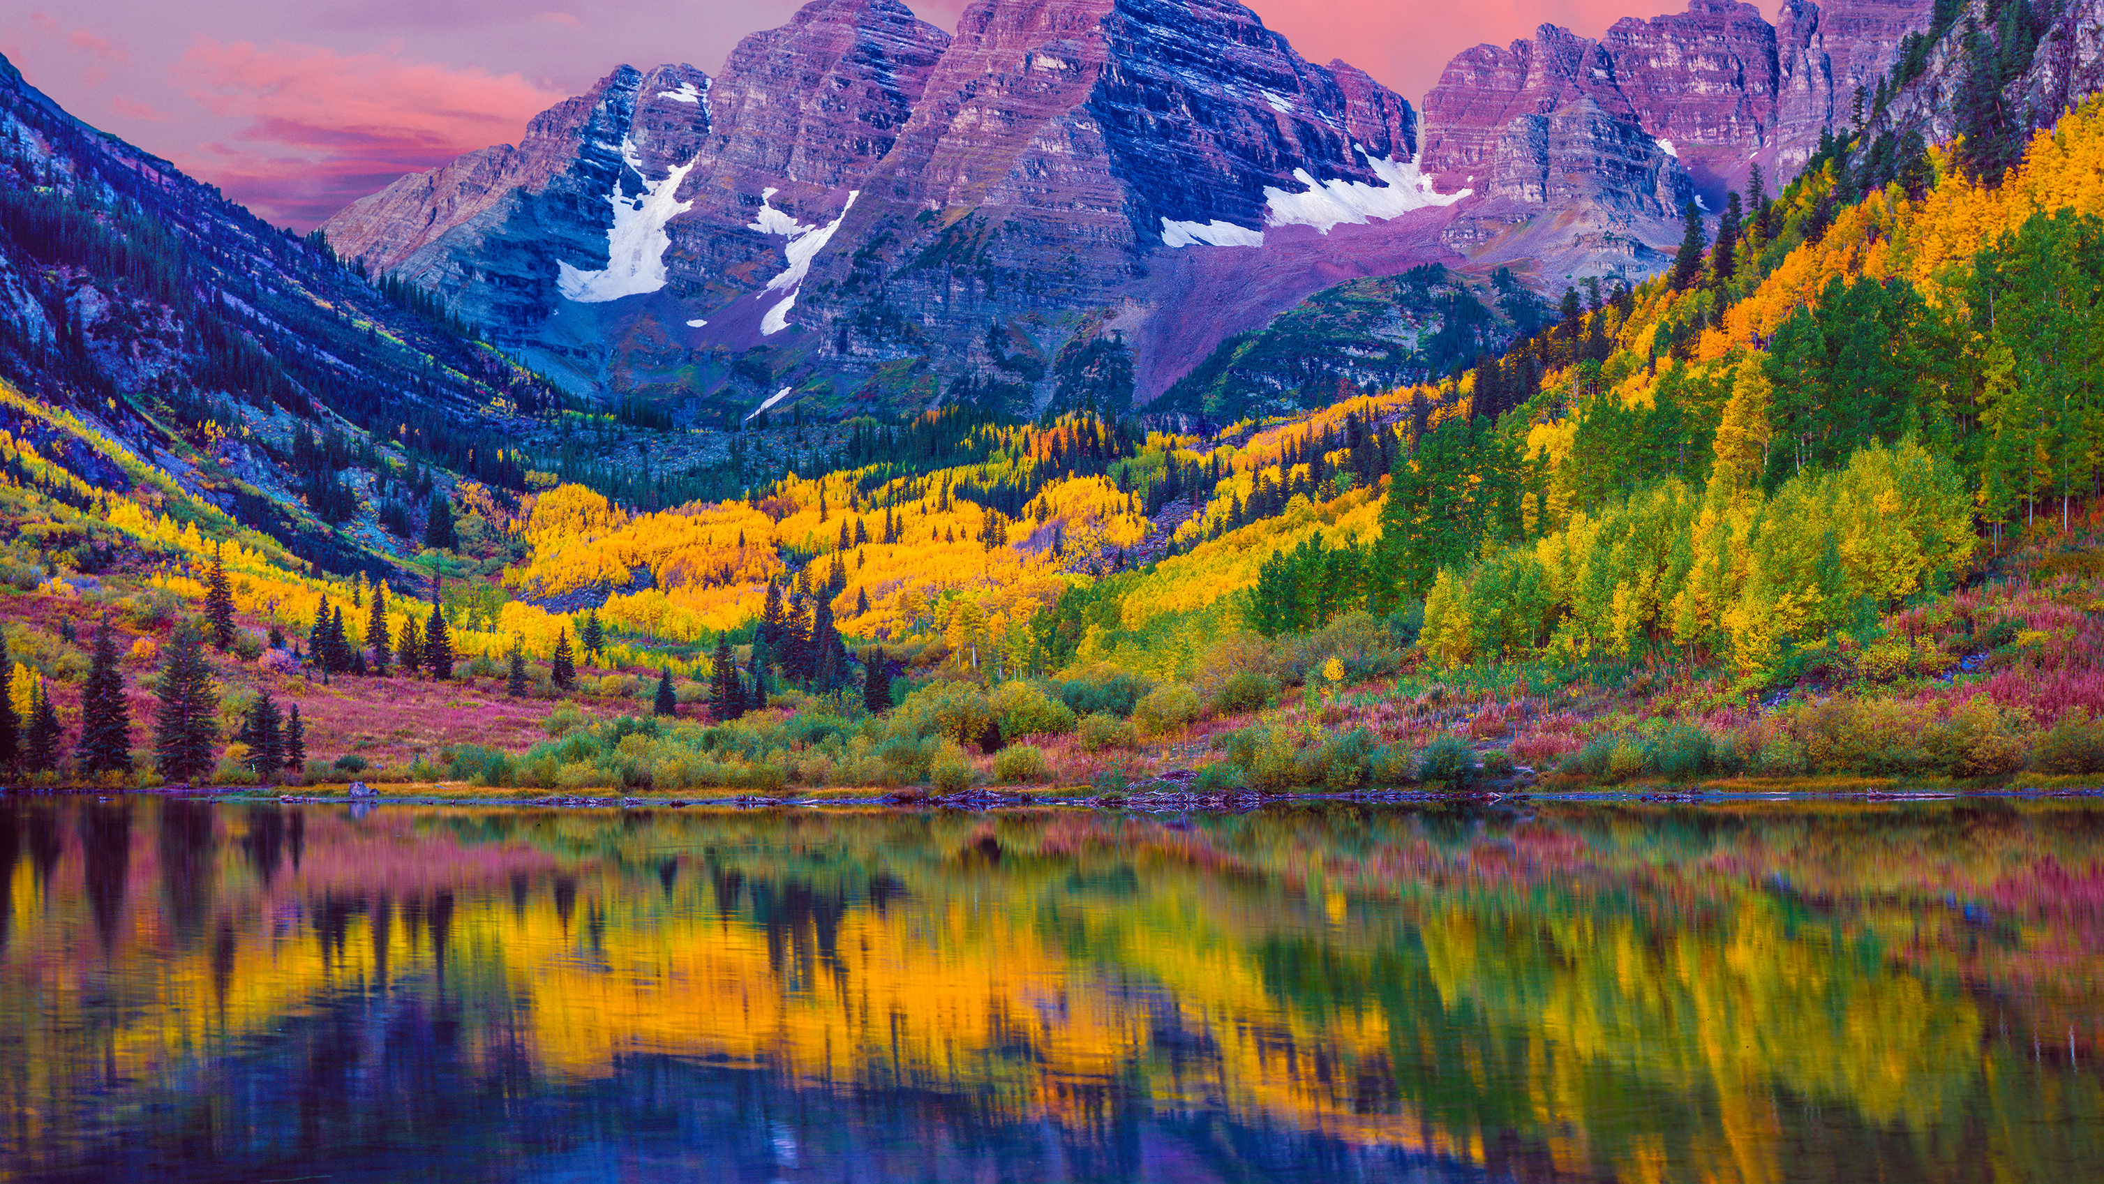

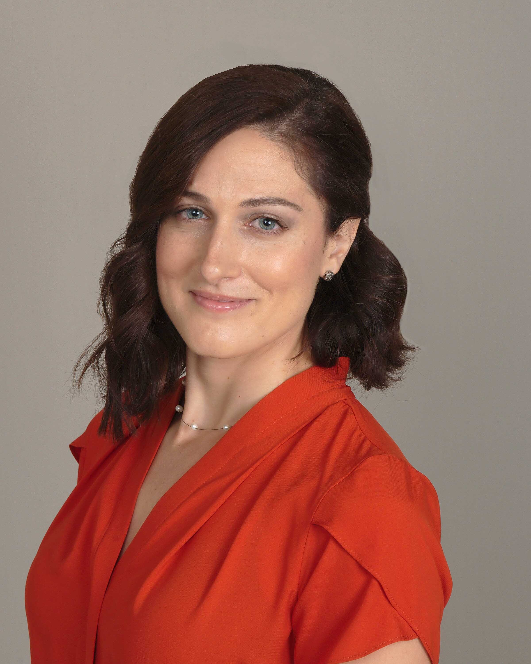
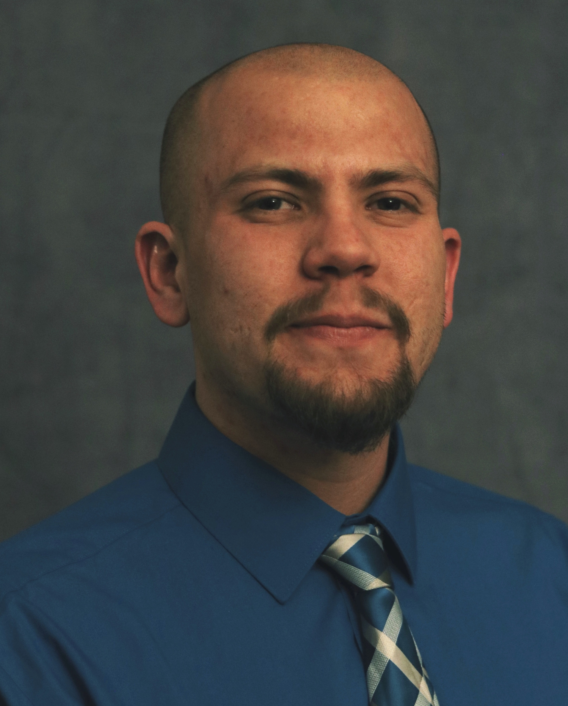



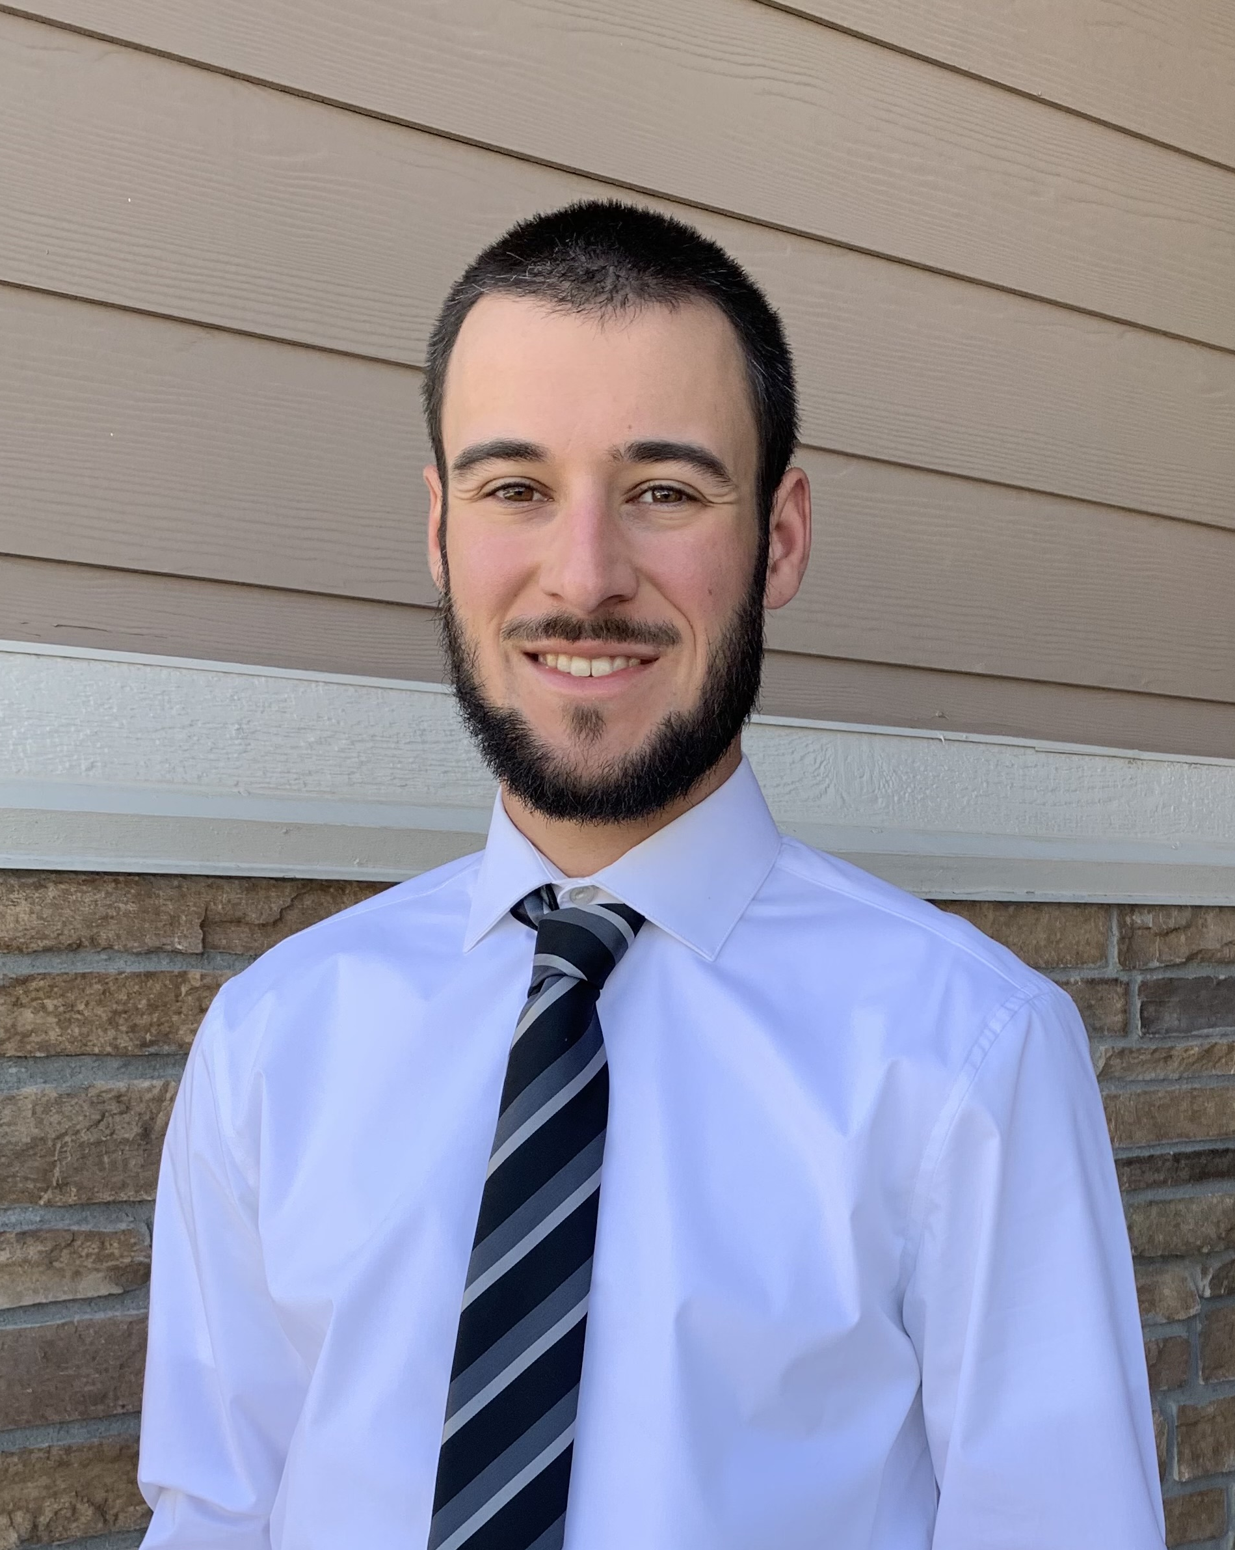


Meet the User Support Team
Layla Freeborn
Brandon Reyes
Andy Monaghan
Michael Schneider
John
Reiland
Dylan Gottlieb
Mohal Khandelwal
Ragan
Lee
Notes:
Before we jump in, a quick shoutout to our awesome User Support Team

Slide 4
Overview
Goals:
Understand containerization in HPC context
Learn Apptainer for ML workloads
Run TensorFlow and PyTorch containers
Submit jobs with SLURM
Agenda:
Intro to containers
Apptainer deep-dive
TensorFlow & PyTorch demos
SLURM integration
Best practices & troubleshooting tips

Slide 5
Why Containers for ML in HPC?
Dependency Management
Package complex ML software stacks with all dependencies.
Resolve version conflicts and avoid "dependency hell."
Portability
Run the same environment across different HPC systems, local machines, or cloud platforms.
"Build once, run anywhere."
Scalability
Easily scale workloads from a laptop to thousands of nodes.
Integrate seamlessly with schedulers like SLURM for large ML jobs.

Slide 6
Why Containers for ML in HPC? (cont.)
Reproducibility
Capture the exact software environment for consistent, repeatable results.
Performance
Near-native speed with minimal overhead; direct access to GPUs and high-speed interconnects.
Optimized images can boost job throughput and resource utilization.

Slide 7
Containerization Concepts

Slide 8
What is a container?
An isolated, encapsulated user-space instance.
Runs on a shared OS kernel but has its own:
Filesystem
Processes
Network interfaces (can be configured)
Container Image: A self-contained read-only file (or files) used to run the packaged application
Container: A running instance of a container image
Notes:
Lightweight compared to Virtual Machines (VMs) as they don’t require a full guest OS.

Slide 9
Containers vs. Virtual Machines (VMs)
Feature | Virtual Machine (VMs) | Containers
Isolation | Full (hardware/emulated) | Process/user-space
Guest OS | Full OS per VS | Shares host OS kernel
Setup | Slow (minutes) | Fast (seconds)
Resource Use | Heavy (more RAM/CPU) | Lightweight (minimal overhead)
Portability | Hypervisor-dependent | Build once, run anywhere
Use case | Legacy apps, OS-level isolation | ML, microservices, HPC, CI/CD

Slide 10
Key Components
Container Images
Read-only templates used to create containers.
Contain application code, libraries, dependencies, and metadata.
Examples: Docker Hub images, SIF files (Apptainer).
Runtime Environments
Software that runs containers (e.g., Apptainer, Docker).
Manages container lifecycle, isolation, and resource allocation.

Slide 11
Key Components (cont.)
Mount Points for Data (Bind Mounts)
Mechanism to make host directories/files accessible inside the container.
Essential for accessing datasets, scripts, and output directories.
Resource Allocation
Containers share host resources (CPU, memory, GPUs).
HPC schedulers (like SLURM) manage resource allocation for containerized jobs.

Slide 12

Apptainer (formerly Singularity)
Apptainer is the direct successor to Singularity.
Requires a Linux system
Runs without requiring root access
Single-file SIF format is easy to transport and share with others
Can convert existing Docker images to Apptainer images
Apptainer comes pre-installed on all Alpine compute nodes, so no need to load any specific software modules!

Slide 13
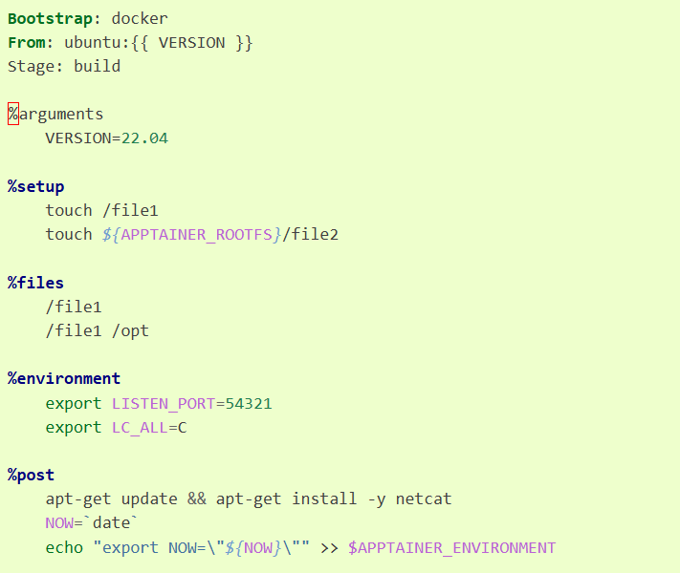
Apptainer Definition Files
A Definition File (or “def file” for short) is a set of blueprints explaining how to build a custom container.
It includes specifics about the base OS, software to install, environment variables and other metadata.
https://apptainer.org/docs/user/1.0/definition_files.html
Notes:
SIF = singularity image file

Slide 14
Working with Apptainer on CURC
View list of Apptainer commands.
$ apptainer --help
Look at CURC's collection of pre-build containers.
$ echo $CURC_CONTAINER_DIR
$ ls $CURC_CONTAINER_DIR
By default, the cache directory for Apptainer builds is /scratch/alpine/$USER
$ echo $APPTAINER_CACHEDIR
Notes:
SIF = singularity image file

Slide 15
Working with Apptainer on CURC
On CURC systems, a running container automatically bind mounts these paths: /home/$USER, $PWD.
To bind any additional folders/files to your container, use the -B flag in your apptainer run, exec, and shell commands:
$ apptainer run -B /source/directory:/target/directory sample-image.sif
$ apptainer run -B /projects/$USER,/pl/active,/scratch/alpine/$USER sample-image.sif
Notes:
SIF = singularity image file

Slide 16
Useful Commands
apptainer inspect #See labels/environment vars, run scripts
apptainer pull #pull an image from hub
apptainer exec #Execute a command to your container
apptainer run #Run your image as an executable
apptainer build #Build a container
apptainer shell #Access the command line of your container
Notes:
SIF = singularity image file

Slide 17
Using images from a pre-built container
You can fetch container images from container registries such as:
Docker Hub
NVIDIA NGC Catalog
Let’s walk through an example of using pre-built Tensorflow container to train a classification model

Slide 18
Getting Started with TensorFlow
1. Export paths
$ export IMAGES=/projects/$USER/containers/sif
$ export WORKDIR=/projects/$USER/containers/ml_work
$ mkdir -p $IMAGES $WORKDIR && cd $WORKDIR
2. Pull TensorFlow container (GPU version)
$ apptainer pull $IMAGES/ tensorflow-2.20.0.sif docker://tensorflow/tensorflow:latest-gpu
3. Inspect container metadata
$ apptainer inspect $IMAGES/tensorflow-2.20.0.sif
Notes:
See labels, environment variables, or definition file info.
Good way to verify if the image has CUDA/GPU, Python, etc

Slide 19
Getting Started with TensorFlow
1. Export paths
$ export IMAGES=/projects/$USER/containers/
$ export WORKDIR=/projects/$USER/containers/ml_work
$ mkdir -p $IMAGES $WORKDIR && cd $WORKDIR
2. Pull TensorFlow container (GPU version)
$ apptainer pull $IMAGES/tensorflow-2.15.0-cuda12.8.sif docker://tensorflow/tensorflow:2.15.0-gpu
3. Inspect container metadata
$ apptainer inspect $IMAGES/tensorflow-2.15.0-cuda12.8.sif
Notes:
See labels, environment variables, or definition file info.
Good way to verify if the image has CUDA/GPU, Python, etc

Slide 20
Binding Paths & Running TF Script
Bind mount your script directory.
Create minst_tf.py that builds and trains a simple image classification model
--nv: Enables NVIDIA GPU access.
4. Bind paths
$ apptainer exec -B $WORKDIR:/work,$IMAGES:/images $IMAGES/tensorflow-2.15.0-cuda12.8.sif ls /work
5. Run the script
$ apptainer exec --nv -B $WORKDIR:$WORKDIR $IMAGES/ tensorflow-2.15.0-cuda12.8.sif python3 $WORKDIR/mnist_tf.py

Slide 21
Sample TensorFlow Script
cat >mnist_tf.py <<'PY'
import tensorflow as tf
mnist = tf.keras.datasets.mnist
(x_train, y_train), _ = mnist.load_data()
x_train = x_train / 255.0
model = tf.keras.models.Sequential([
tf.keras.layers.Flatten(input_shape=(28,28)),
tf.keras.layers.Dense(128, activation='relu'),
tf.keras.layers.Dropout(0.2),
tf.keras.layers.Dense(10, activation='softmax')
])
model.compile(optimizer='adam', loss='sparse_categorical_crossentropy', metrics=['accuracy'])
model.fit(x_train, y_train, epochs=1)
print("Done training.")
PY

Slide 22
Access container interactively
Shell into it
$ apptainer shell --nv $IMAGES/tensorflow-2.15.0-cuda12.8.sif
Then run
$ python3
>>> import tensorflow as tf
>>> tf.__version__
>>> tf.config.list_physical_devices('GPU')
If it returns a list (e.g. [PhysicalDevice(name='/physical_device:GPU:0', ...)]), then TensorFlow successfully detected the GPU inside the container!
Notes:
SIF = singularity image file

Slide 23
SLURM Integration
#!/bin/bash
#SBATCH --gres=gpu:1
#SBATCH --partition=aa100
#SBATCH --ntasks=4
#SBATCH --nodes=1
#SBATCH --qos=normal
#SBATCH --time=1:00:00
#SBATCH --job-name=tf-classify
#SBATCH --output=tf-classify.%j.out
#SBATCH --mail-type=ALL
#SBATCH --mail-user=<your email>
export IMAGES=/projects/$USER/containers/sif export WORKDIR=/projects/$USER/containers/ml_work mkdir -p $IMAGES $WORKDIR && cd $WORKDIR
apptainer exec --nv -B $WORKDIR:$WORKDIR $IMAGES/tensorflow-2.20.0.sif python3 $WORKDIR/mnist_tf.py

Slide 24
Getting Started with PyTorch
1. Export paths
$ export IMAGES=/projects/$USER/containers/
$ export WORKDIR=/projects/$USER/containers/ml_work
$ mkdir -p $IMAGES $WORKDIR && cd $WORKDIR
2. Pull TensorFlow container (GPU version)
$ apptainer pull $IMAGES/pytorch-2.9.0-cuda12.8.sif docker://pytorch/pytorch:2.9.0-cuda12.8-cudnn9-runtime
3. Inspect container metadata
$ apptainer inspect $IMAGES/ pytorch-2.9.0-cuda12.8.sif
Notes:
See labels, environment variables, or definition file info.
Good way to verify if the image has CUDA/GPU, Python, etc

Slide 25
Run PyTorch Container
Bind mount your script directory.
Create polyfit.py that builds and trains a small neural network
4. Bind paths
$ apptainer exec -B $WORKDIR:/work,$IMAGES:/images $IMAGES/pytorch-2.9.0-cuda12.8.sif ls /work
5. Run the script
$ apptainer exec --bind $WORKDIR:$WORKDIR $IMAGES/pytorch-2.9.0-cuda12.8.sif python3 $WORKDIR/polyfit.py

Slide 26
Sample PyTorch script
cat >polyfit.py <<'PY'
import torch
x = torch.linspace(-1, 1, 100).unsqueeze(1)
y = 3 * x ** 2 + 2 * x + 1 + 0.1 * torch.randn(x.size())
model = torch.nn.Sequential(torch.nn.Linear(1, 10), torch.nn.ReLU(), torch.nn.Linear(10, 1))
loss_fn = torch.nn.MSELoss()
optimizer = torch.optim.Adam(model.parameters())
for epoch in range(100): optimizer.zero_grad(); loss_fn(model(x), y).backward(); optimizer.step()
print("Done training.")
PY

Slide 27
Troubleshooting Common Issues
Check GPU access:
apptainer exec --nv $IMAGES/tensorflow-2.15.0-cuda12.8.sif python3 -c "import tensorflow as tf; print(tf.config.list_physical_devices('GPU'))"
Environment variables:
Pass with --env or set inside the container.
Cache management:
apptainer cache list and apptainer cache clean
Resource monitoring:
Use htop, nvidia-smi, or squeue to monitor jobs.

Slide 28
Best Practices: Container Management
Version Control & Tagging
Tag containers with specific versions (e.g., myimage:1.0.0, myimage:latest-cuda11.8).
Store definition files (.def, Dockerfiles) in version control (Git).
Data Management
Use bind mounts for large datasets to avoid including them in images.
Keep images small and focused on software environment.
Resource Allocation
Match container resource needs to SLURM (or other scheduler) requests.
Avoid over-subscribing resources.

Slide 29

Any Questions

Slide 30

Thank you!
http://tinyurl.com/curc-survey18
Survey and feedback

